Slide 1
Garbage collection in .NET
Comparing with Java, Python and JavaScript approaches
Author: Yuriy Shapovalov

Slide 2
Agenda
Reference counting vs. tracing
Memory allocation process
Mark and sweep (and compact) algorithm
Generations
Dispose pattern

Slide 3

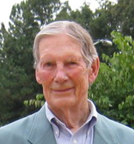
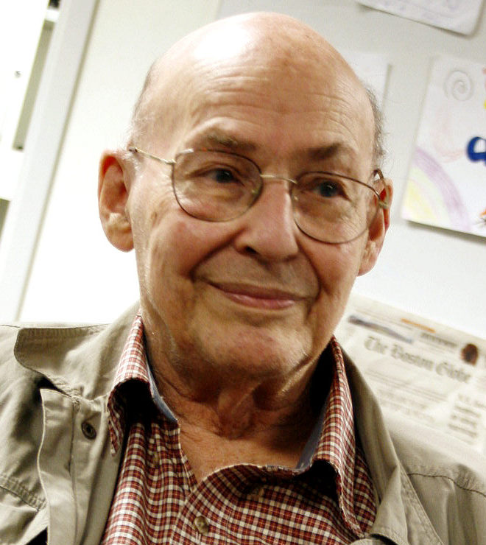
GC Algorithms
Tracing [McCarthy, 1960]
Reference Counting [Collins, 1960]
Copying Collection [Minsky, 1963]

Slide 4
Tracing (mark and sweep)
Stop process
Trace forward from roots
Everything touched in live, all else is garbage
Roots

Slide 5
Tracing (mark and sweep)
Stop process
Trace forward from roots
Everything touched in live, all else is garbage
Roots

Slide 6
Reference Counting
Each object has counter of incoming pointers
When counter reaches zero, object can be collected.
root
1
2
0
1
2
0
1
0
2
3
1

Slide 7
Reference Counting
Each object has counter of incoming pointers
When counter reaches zero, object can be collected.
root
1
2
0
1
2
0
1
0
2
3
1

Slide 8
Reference Counting
Each object has counter of incoming pointers
When counter reaches zero, object can be collected.
root
1
1
1
2
0
1
2
1

Slide 9
Memory Allocation process
Before CLR executes the first line of the managed code, it creates three application domains.
System Domain
Shared Domain
Default AppDomain
Define size of object MyClass
Allocate memory
MyClass instance = new MyClass();

Slide 10
Memory Allocation process
Define size of object MyClass
Allocate memory
MyClass instance = new MyClass();

Slide 11
CLR Bootstrap

Slide 12
Mark and Sweep
Roots
Processes
global
stack
CPU registers
stack
stack

